Slide 1




AI ON EDGE DEVICES
GROUP 2
Object Detection and Pose Estimation with ROS2 Integration
TEAM MEMBERS:
OLUWATUNMISE SHUAIBU
ARASH BAZRAFSHAN
MYU WAI SHIN
PDE3802 AI IN ROBOTICS
MIDDLESEX UNIVERSITY LONDON
DEC 2025
1

Slide 2

Project Aim & Objectives
The aim of this project is to design and implement a vision-based perception system on a Raspberry Pi that can detect multiple objects, estimate their poses, and publish their positions as TF frames relative to the camera in ROS.
Objectives
Detect five different objects using a camera connected to a Raspberry Pi
Estimate object pose using two different approaches:
2 objects with ArUco markers
3 objects without markers
Compute object coordinates relative to the camera frame
Publish object poses as TF frames for real-time visualisation in RViz
Evaluate detection reliability and pose accuracy under embedded hardware constraints
2

Slide 3
Problem Statement
While fiducial markers such as ArUco tags make pose estimation reliable, they are not always available or practical in real-world environments.
Marker-less pose estimation is more flexible but significantly more challenging, especially when deployed on resource-limited platforms like the Raspberry Pi.
This project tackles these challenges by combining marker-based and marker-less pose estimation methods within a single ROS-based pipeline, and by publishing all detected object poses as TF frames, allowing consistent spatial representation and visual validation in RViz.
3

Slide 4
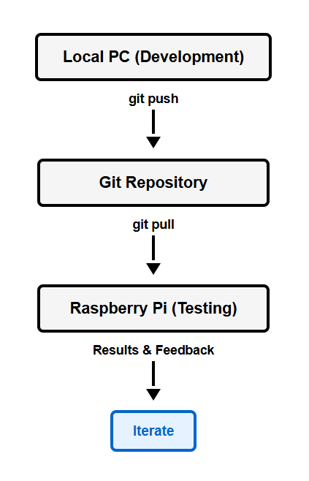
Git-Based Development Workflow:
Initial Setup:
Shared Git repository created at project start
All collaborators added with SSH access configured
Remote deployment enabled from development PC to Raspberry Pi
Iterative Development Process:
Code developed and tested on local PC
Changes pushed to repository
Raspberry Pi pulls latest code for hardware testing
Results inform next iteration
Benefits:
Consistent codebase across devices
Easy rollback when optimizations failed
Rapid testing cycles with synchronized environments
4

Slide 5
Identifying High-Risk Components
Our Analysis
After reviewing the assessment brief and all required components, we identified markerless pose estimation as the most challenging aspect of the project. Unlike ArUco-based detection, markerless objects have no predefined reference pattern and are highly sensitive to texture, lighting, and object geometry.
Why This Became Our Focus
Markerless pose estimation posed the highest risk of failure.
Early progress here was critical to prevent downstream bottlenecks.
We began by evaluating which objects were suitable based on texture richness, shape consistency, and lighting robustness.
5

Slide 6
Approach 1 – Keypoint Based Pose Estimation
What Is Keypoint Detection?
A computer vision technique that identifies distinct, repeatable points on an object (e.g., corners, edges, textured regions).
These keypoints are then described using feature descriptors (e.g., ORB, SIFT) and matched across images.
Once we match 2D image keypoints to known 3D keypoints, we can compute the object’s 6-DoF pose using PnP (Perspective-n-Point).
Why Keypoint Detection Suits Our Project
Works well for markerless objects that have enough texture or geometric features.
Lightweight algorithms like ORB run efficiently on Raspberry Pi.
Provides both object detection and pose estimation without needing markers.
Robust to partial occlusion and changes in orientation.
Allows us to build a feature-based 3D model of the object for accurate pose recovery.
6

Slide 7
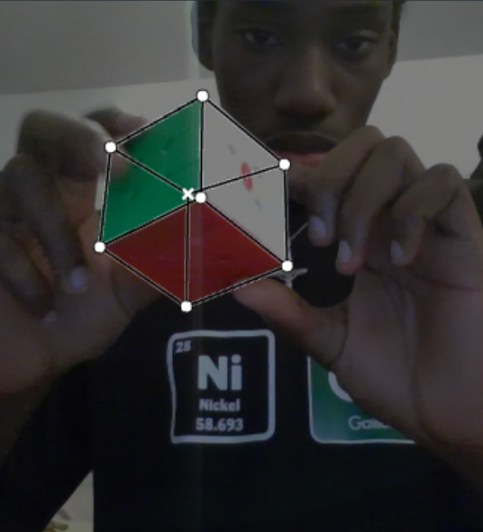
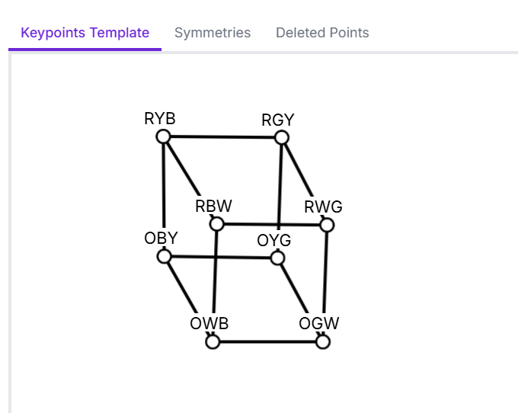
Keypoint Detection: Experimental Setup
Object Chosen: Rubik’s Cube
Chosen because it has a strong geometric pattern and distinct features that should theoretically produce stable keypoints.
Despite being a good candidate, we found the method still failed.
Dataset Preparation:
Manually annotated the Rubik’s cube using RoboFlow.
Performed augmentation to expand dataset to 120 training images.
Manual annotation was extremely time-consuming, especially for fine keypoint definition.
7

Slide 8
Keypoint Detection: Training Results
Action
We trained the keypoint model on our Rubik’s Cube dataset, but both detection and pose estimation performed poorly.
Detection Outcome
The model frequently misidentified unrelated objects as the Rubik’s cube.
Bounding box predictions were inconsistent and unstable across test images.
The model demonstrated clear signs of overfitting to the small dataset.
Keypoint/Pose Outcome
The pose/keypoint branch failed to learn meaningful geometric patterns.
F1, precision, and recall scores for pose estimation were near-zero across all thresholds.
Even in cases where the cube was detected, the predicted pose was completely inaccurate.
Why This Happened
120 images (even with augmentation) is far too small for pose learning.
Rubik’s cube has complex, repeating patterns, causing confusion.
Manual annotation errors accumulate quickly in pose estimation tasks.
YOLO’s keypoint head requires highly varied data to learn stable correspondences.
8

Slide 9
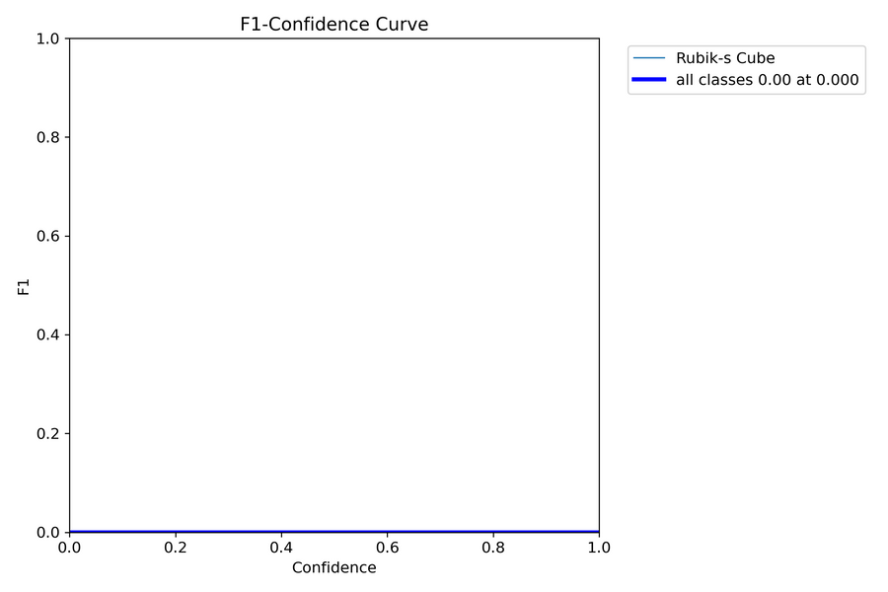
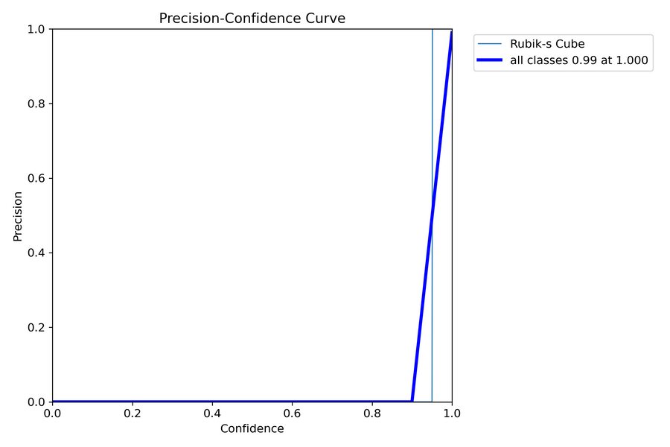
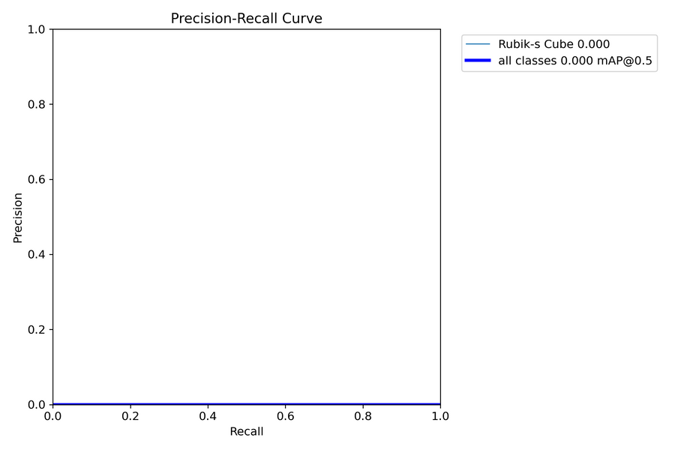
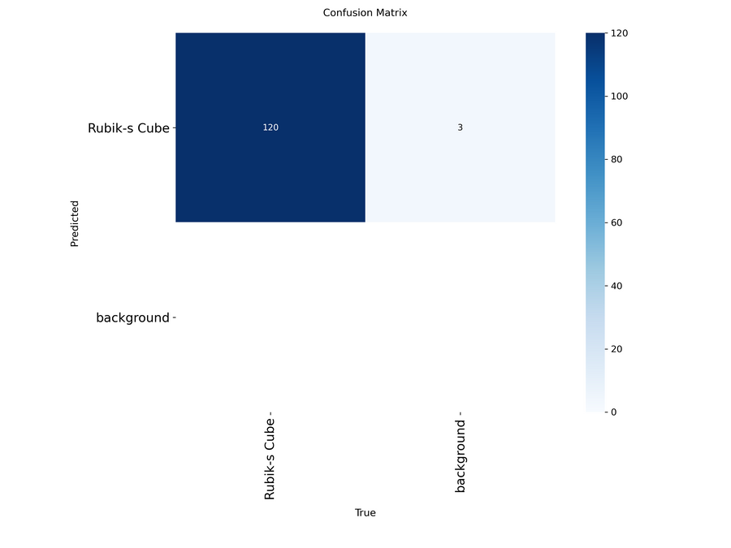
Keypoint Detection: Training Results
Both detection and pose estimation showed poor generalization, with many false positives and near-zero pose accuracy.
9

Slide 10
Keypoint Detection — Evaluation & Pivot
Overall Evaluation
Despite training the model and running experiments, the overall system performance was not usable:
Detection was unstable, with many false positives.
Keypoint/pose estimation produced no reliable results.
The model struggled to generalize across new test images.
Limitation Identified
To improve these results, we would have needed:
Significantly more data
Much more diverse viewpoints
Extensive manual annotation, which was not feasible within the project timeframe
At this stage, it became clear that continuing with keypoint detection would not be an efficient use of time.
Decision
We decided to pivot to alternative markerless pose estimation approaches that would require less annotation effort and deliver more reliable performance.
10

Slide 11
Exploring New Approaches
After pivoting from keypoint detection:
We restarted our research to find a simpler, more reliable method for markerless pose estimation — ideally one that doesn’t require heavy annotation or large datasets.
What We Found
During this exploration, we came across homography, a geometry-based approach that uses point correspondences on a planar object to estimate its pose.
Why This Was Promising
No dataset needed
No manual keypoint labelling
Works well for planar, structured objects
11

Slide 12
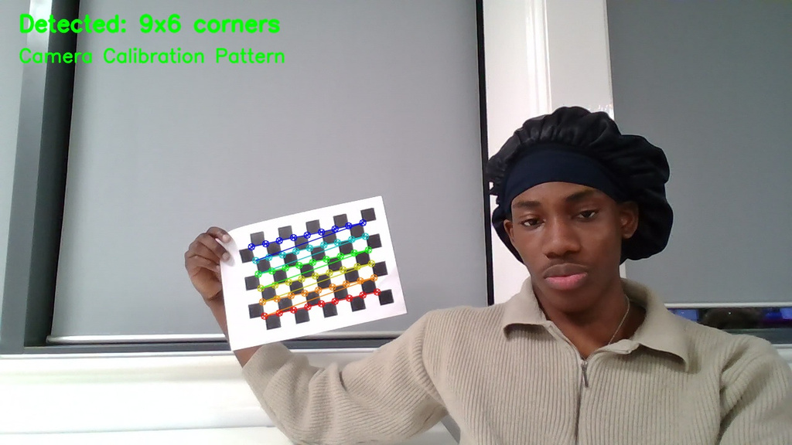
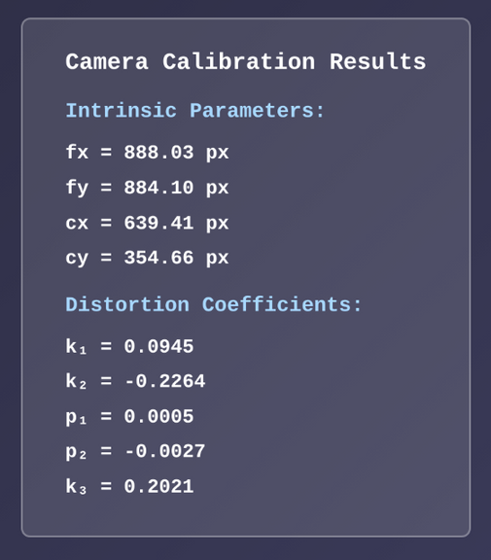
Camera Calibration
Why Calibration is Essential:
Homography computation requires accurate camera intrinsic parameters
Distortion correction ensures reliable feature correspondence
Enables transformation from 2D image plane to 3D world coordinates
Calibration Process:
Used checkerboard pattern with known dimensions
Captured multiple images at various angles and distances
Computed camera matrix and distortion coefficients using OpenCV
Calibration Parameters Obtained:
Camera intrinsic matrix (fx, fy, cx, cy)
Radial and tangential distortion coefficients
12

Slide 13
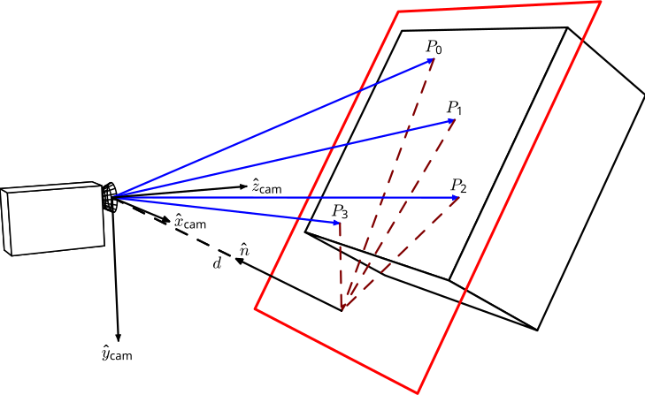
Approach 2 – Homography-Based Pose Estimation
What Is Homography?
Homography is a geometric transformation that maps one plane to another using four or more point correspondences.
In simple terms:
If an object has a flat, identifiable surface, we can use homography to understand how it’s rotated and positioned in the camera view.
Why It Works for Our Project
Our chosen object has a planar region (e.g., a face with a clear pattern).
We only need to detect a few corner points — no big dataset required.
Much easier than training a model for keypoints.
Provides a stable mathematical way to estimate object pose.
Runs efficiently on the Raspberry Pi.
Required no manual annotation
Allowed faster iteration and testing
Was realistic to implement within the assessment timeframe
13
Link to Homography Wiki

Slide 14
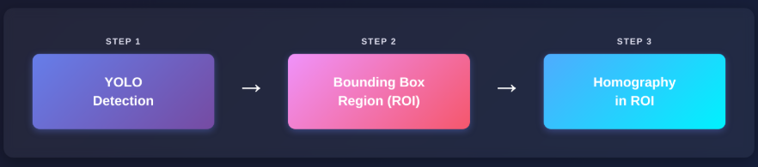
Approach 2 – Homography-Based Pose Estimation
With an approach we were finally confident in, we moved on to properly attempting the assessment requirements:
Object Selection
ArUco objects: headset, wallet
Marker-less objects: repair mat, notebook, game box
Detection Model Training
YOLO detection model trained with:
~2,800 images per class
~14,000 images in total
Pipeline Implementation
YOLO detection identifies objects and defines bounding box regions
Homography computed within detected regions for pose estimation
14

Slide 15
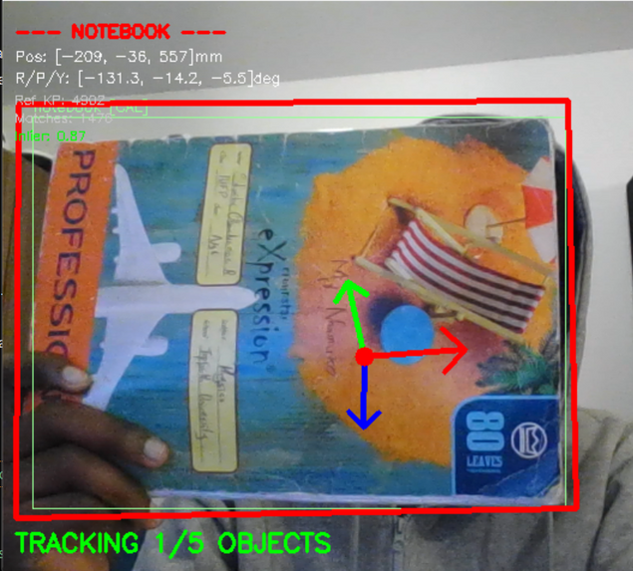
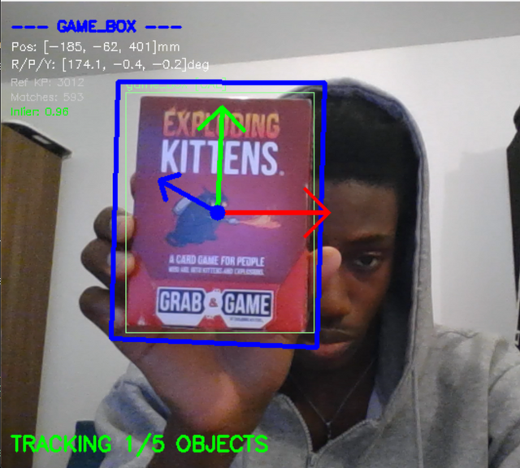
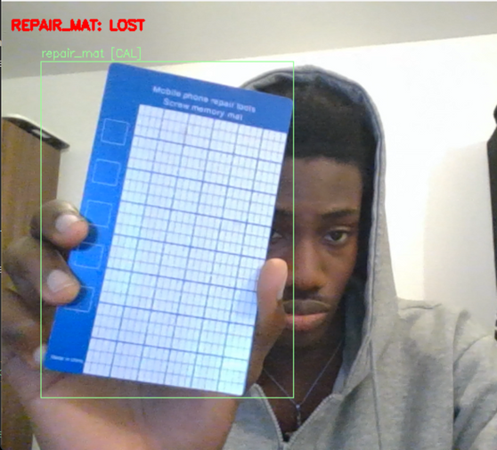
Approach 2 – Homography Results - First Iteration
Detection Performance:
All 5 objects detected successfully by YOLO
Markerless Objects:
Notebook: Homography computed successfully, pose estimation functional
Game Box: Homography computed successfully, pose estimation functional
Repair Mat: Homography failed - insufficient texture density for reliable feature correspondence
15

Slide 16
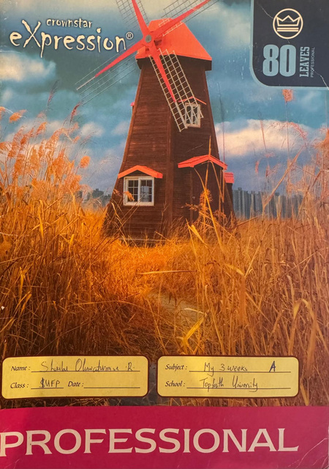

Understanding Homography Requirements
Why Did Repair Mat Fail?
Although the repair mat appeared suitable (planar surface with grid pattern), homography failed due to insufficient texture contrast.
What is "Texture" in Computer Vision?
Distinctive, high-contrast features that can be reliably detected and matched across images
Variation in intensity, color, or patterns at multiple scales
Not just visible patterns - must have strong gradients for feature detection
Critical Requirements for Homography-Based Pose Estimation:
Planar Surface: Object must have a flat, identifiable face
Rich Texture: High-contrast features with distinctive patterns
Camera Calibration: Accurate intrinsic parameters essential for pose computation
Textured Object
Low Textured Object
16

Slide 17
System Refinement – Modular Architecture
Since homography showed promising results, further refinement was required to improve stability. To support rapid testing and future improvements, the system was redesigned to be modular, allowing different pose estimation methods to be swapped easily.
Key Features:
Centralized object configuration (dimensions, method, thresholds)
Multi-method support (homography + ArUco in one pipeline)
Swappable YOLO models with automatic class mapping
Independent parallel tracking per object
Benefits:
Rapid iteration and A/B testing
Simplified debugging and collaboration
17

Slide 18
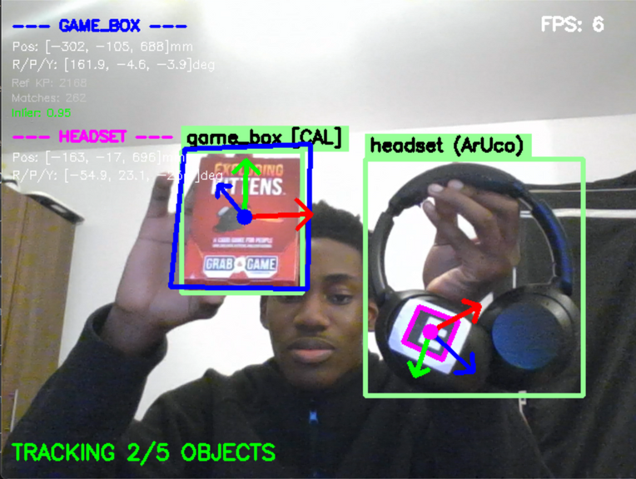
System Refinement – Modular System Results
System Performance:
Both homography and ArUco methods working simultaneously
Multiple objects tracked in parallel
Stable pose estimation across different method types
Key Achievement: The modular architecture successfully demonstrated multi-object, multi-method tracking in a unified system, enabling flexible testing and rapid iteration.
18

Slide 19
Object Refinement - Second Iteration
Based on initial testing results, objects were refined to better suit their respective tracking methods.
Objects Swapped Out:
Wallet → E-stop button
Headset → Phone
Repair mat → Circuit board
Game box → Card game
Rationale for Changes:
E-stop and phone: Better ArUco marker placement, more stable surfaces
Circuit board & card game: Richer texture pattern, improved feature density for homography
Training Process:
New YOLO model trained with updated object set
~2,800 images per class maintained
Total dataset: ~14,000 images
Successfully integrated new objects into modular system with no code restructuring required - demonstrating the benefit of the modular architecture.
19

Slide 20
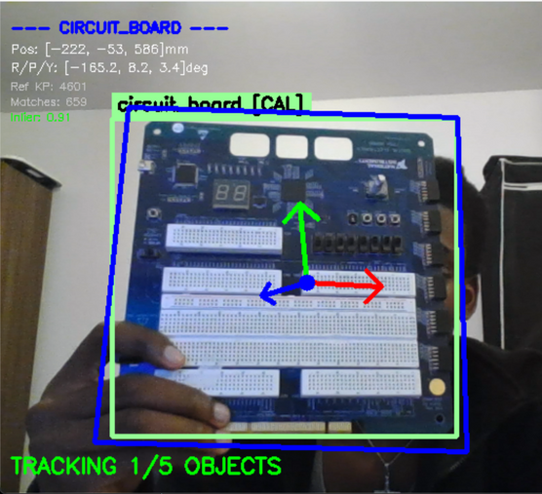
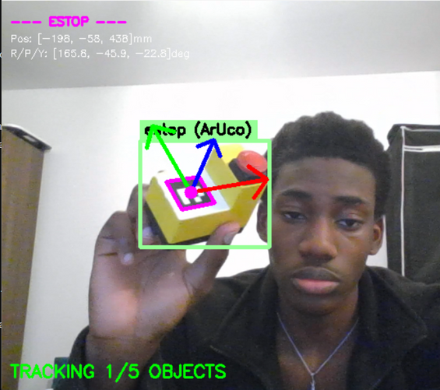
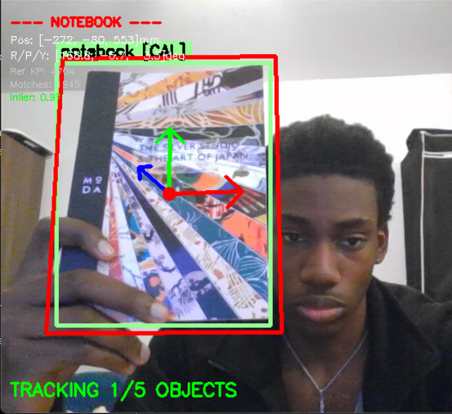
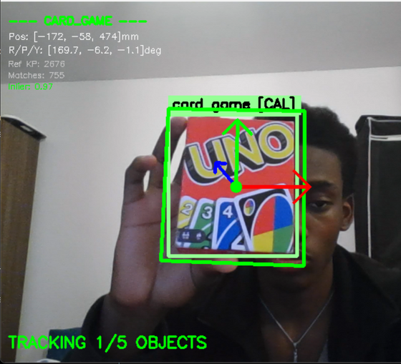
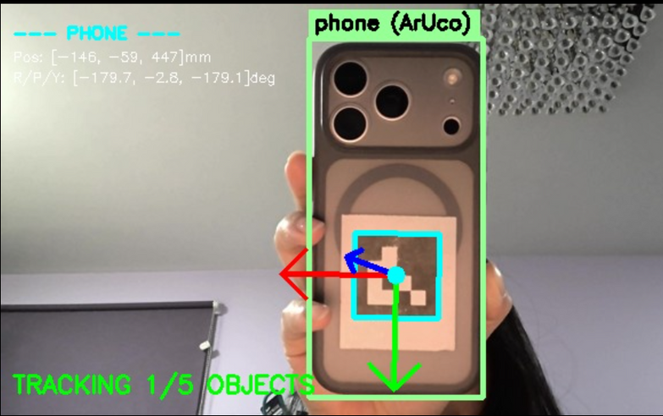
Object Refinement - Second Iteration Results
System Validation: All 5 objects successfully tracked with 6DOF pose estimation. New object selection increased feature detection rates and tracking reliability.
Next Step: With the system demonstrating promising results, focus shifted to ROS2 integration for embedded deployment on Raspberry Pi.
20

Slide 21
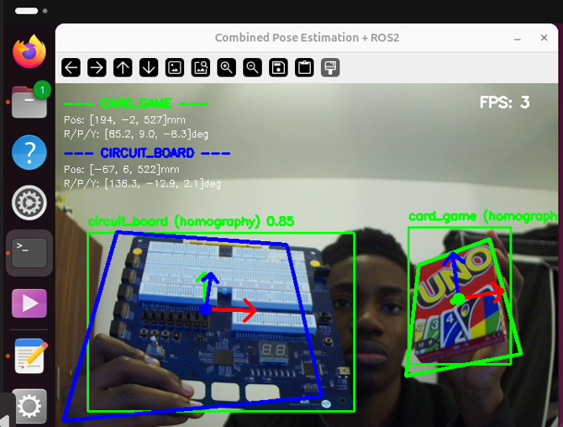
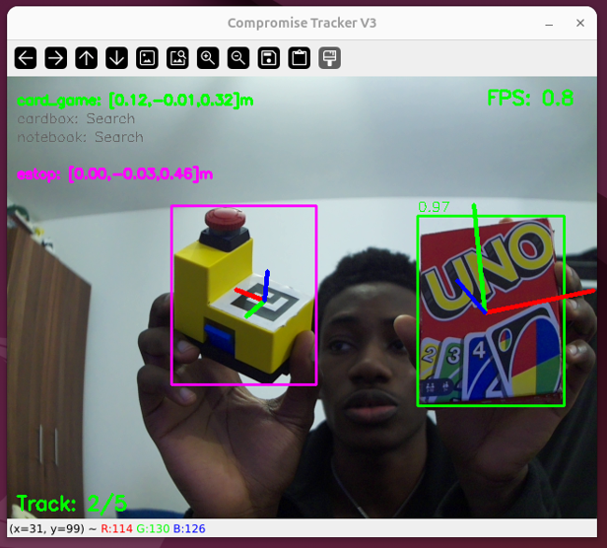
Raspberry Pi Deployment
Transition to Embedded System: Code transferred to Raspberry Pi 4 for real-time embedded operation using Git for version control and consistent iteration across development environments.
Camera Pipeline Adaptation:
Standard OpenCV VideoCapture → GStreamer pipeline with libcamera
Raspberry Pi CSI Camera integration
Configuration: 640×480
System Optimizations:
Adaptive frame skipping for YOLO (1-3 frames based on detection state)
Optimized ORB feature computation pipeline
Memory-efficient buffering for real-time performance
Performance: Multi-object tracking successfully maintained on embedded hardware, though processing limitations resulted in reduced frame rates. Pose estimation axes exhibited jitter due to frame-to-frame variations in feature matching and homography computation.
21

Slide 22
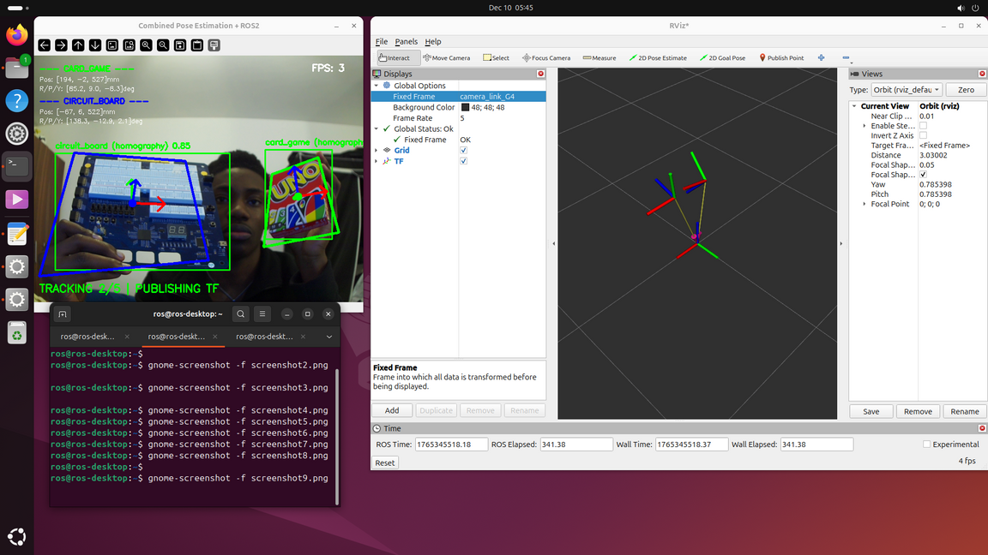
ROS2 Integration & TF Publishing
ROS2 Framework Integration: System extended to publish pose data as TF frames, enabling integration with the broader robotics ecosystem.
TF Publishing Architecture:
Static transform: map → camera_link_G4 (fixed reference frame)
Dynamic transforms: camera_link_G4 → {object}_frame for each tracked object
Real-time broadcasting at detection frequency
Published Information:
6DOF pose (position + orientation) for all 5 objects
Position in meters (converted from mm)
Orientation as quaternions (converted from rotation vectors)
22

Slide 23
System Performance & Challenges
Current System Status: Multi-object tracking operational with ROS2 TF publishing successfully implemented across all 5 objects.
Performance Issues:
Low frame rates on Raspberry Pi (~1-3 FPS)
Jittery pose estimation axes due to frame-to-frame feature matching variations
Intermittent homography failures on circuit board tracking
Design Decision: Frame rate optimization deferred in favor of prioritizing system stability and reliability. Focus shifted to improving pose estimation robustness.
Solution Approach: Research into alternative feature-based methods revealed a hybrid tracking Technique combining:
Direct feature-to-3D plane mapping (instead of homography transformation)
Temporal smoothing using previous pose as initial guess for PnP
RANSAC-based outlier rejection with stricter inlier requirements
This approach showed promise for more stable pose estimation with reduced jitter.
23

Slide 24
ORB Feature Detection with Direct 3D Mapping vs Homography
Previous Approach (Homography):
2D feature matching → 2D homography → corner transformation → PnP for pose
New Approach (Direct 3D Mapping):
Features mapped directly to 3D plane during calibration → PnP on 3D-to-2D matches
Previous pose used as initial guess for temporal smoothing
Key Improvement: Eliminates intermediate homography step, reducing geometric errors and jitter.
Result: More stable pose estimation with improved tracking consistency.
This makes our 3rd approach to fulfilling the assessment
24

Slide 25
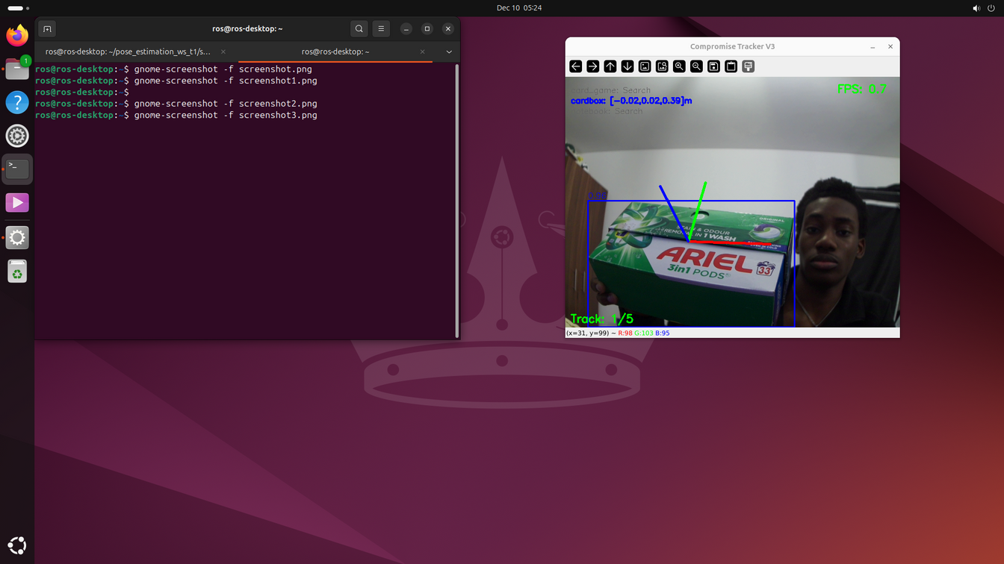
Object Suitability Testing & Final Selection
Automated Testing Implementation: Introduced suitability testing script to systematically evaluate objects before full training cycle, reducing iteration time and ensuring optimal object selection.
Testing Results:
Notebook: Excellent feature density and stability
Card game: Strong performance with consistent tracking
Circuit board: Insufficient texture contrast, intermittent failures
Object Replacement: Circuit board replaced with green cardbox, selected for superior texture characteristics and improved feature detection rates.
25

Slide 26
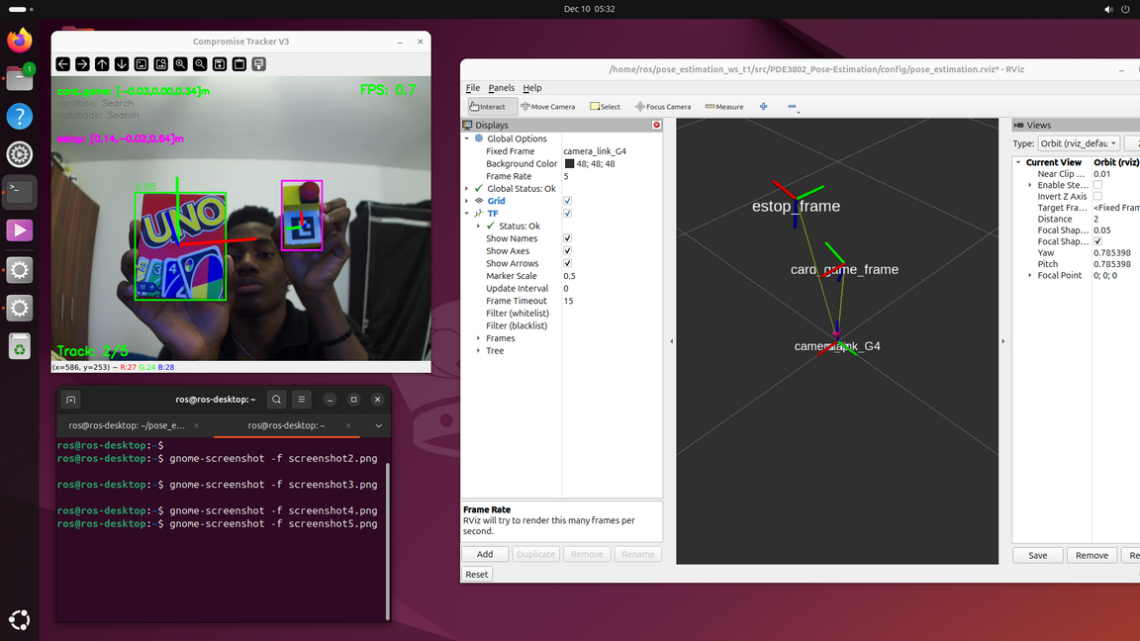
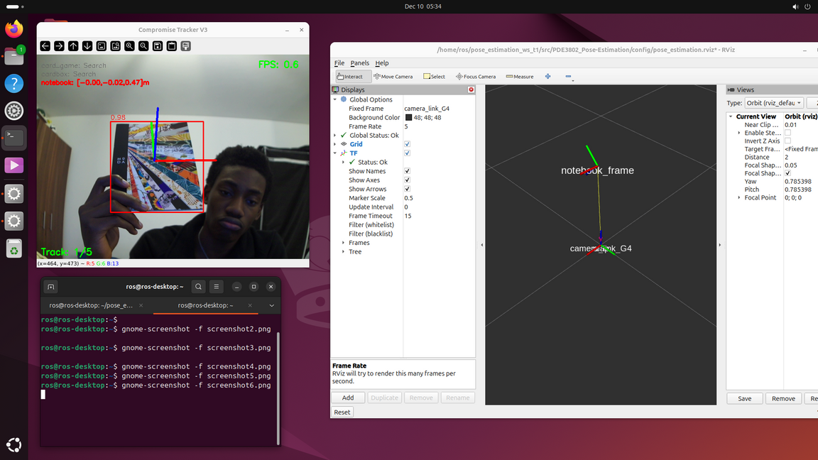
Final System Training & Deployment
Model Retraining:
Detection model retrained with updated object set
Training dataset: ~22,900 images (~4,580 per class)
Full pipeline deployed and tested on Raspberry Pi
Results:
Improved pose stability for feature-based objects
Consistent TF frame visualization in RViz
Minimal pose estimation jitter achieved
Detection and tracking operating reliably
Remaining Challenge: Low frame rate performance requiring optimization.
26

Slide 27
Performance Optimization Attempts
Bottleneck Identification: YOLO inference identified as primary bottleneck (150-300ms per frame on RPi CPU)
Optimization Strategies Attempted: Multiple optimization techniques tested including:
Multi-threading architecture
Model format conversion (ONNX, TFLite, NCNN) [ONNX Successful]
Camera resolution reduction
YOLOv5 alternative model trial
ORB feature count reduction
RANSAC iteration optimization
Adaptive frame skipping (SUCCESSFUL)
Critical Finding: YOLO is both the bottleneck AND essential—tracking cannot function without accurate detections.
Solution Implemented: Adaptive frame skipping reduces YOLO frequency when objects are stable, caching detections between frames while maintaining accuracy.
Result: FPS improved from 0.4 → 1.8-2.0 FPS through intelligent detection caching without compromising tracking reliability.
27

Slide 28
Final System Performance & Conclusions
Current Performance:
System operates reliably at 1.8-2.0 FPS with adaptive frame skipping
All 5 objects tracked with stable 6DOF pose estimation
ROS2 TF publishing functional
Pose estimation jitter minimized through direct 3D mapping approach
Hardware Limitation: Raspberry Pi 4 CPU reaches practical limits for real-time YOLO inference—further optimization yields diminishing returns.
Future Improvements Require:
Hardware acceleration (Coral TPU, Jetson Nano)
C++ implementation with optimized libraries
Alternative lightweight detection architectures
Achievement: Fully functional multi-object 6DOF pose estimation system with ROS2 integration. System demonstrates effective optimization within embedded hardware constraints, achieving 5× FPS improvement through adaptive processing strategies
28

Slide 29
OBJECT DETECTION AND POSE ESTIMATION WITH ROS2 INTEGRATION
GROUP 2
Thank
You
10/DEC/2025
29

